Slide 1



Team HDR: Final Presentation
By Hasibul, Daniel, and Ryan

Slide 2
Problem Statement
Netrality Data Centers is looking to expand its business by targeting new companies to acquire as customers
Provided Three Datasets: Current Customers, Current Billing, Prospect List
(Not including Data Dictionary)
Our goal: To identify a consolidated list of companies that would be most advantageous for Netrality to gear their marketing campaigns toward and acquire as clients
Notes:
Netrality Data Centers is looking to expand its business by targeting new companies to acquire as customers
Aside from the data dictionary, Netrality provided us with a dataframe of current customers, a dataframe of billing coefficients associated with those customers at each Netrality location, and a dataframe of prospect companies they could potentially target in the future
Our goal was to assess the prospect companies based on the criteria of Netrality’s current customers using machine learning models to ultimately identify a consolidated list of companies that would be most advantageous for Netrality to gear their marketing campaigns toward and acquire as clients. It takes time and money to acquire customers. We wanted to determine which of the 1929 prospect companies were actually worth seeking business with in order to optimize profitability

Slide 3

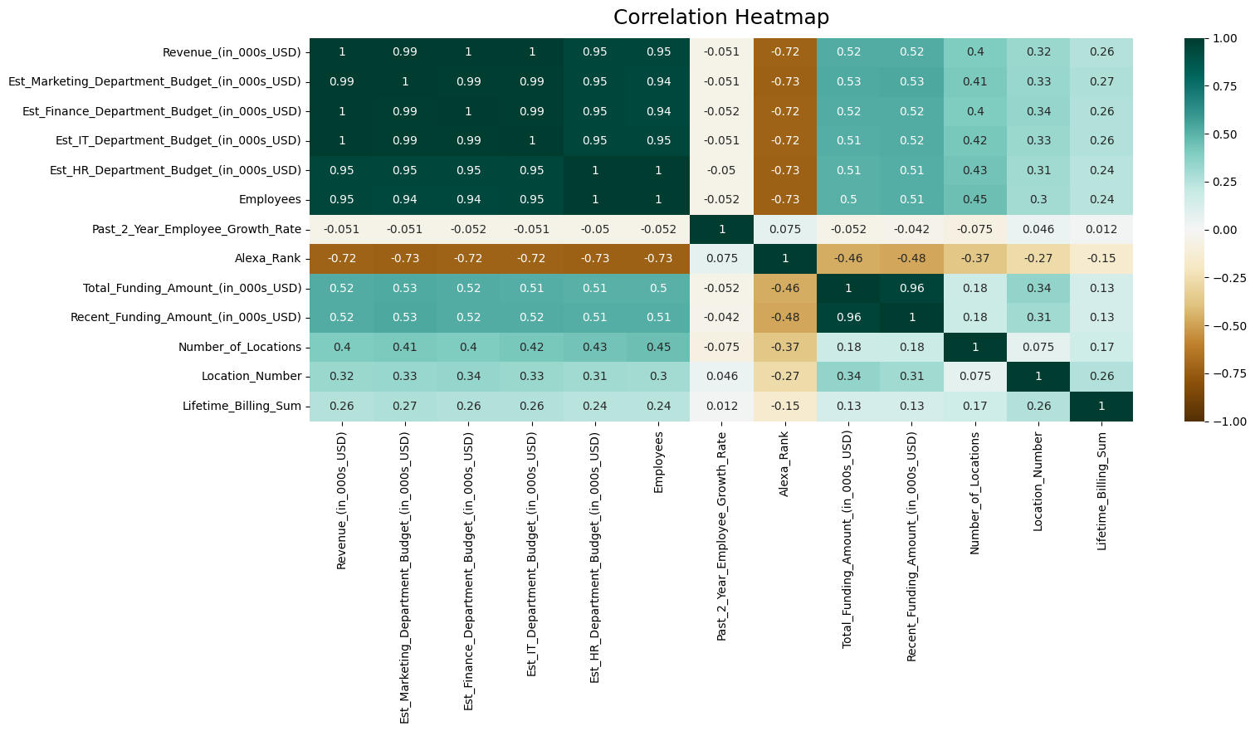
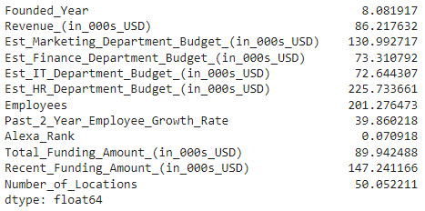
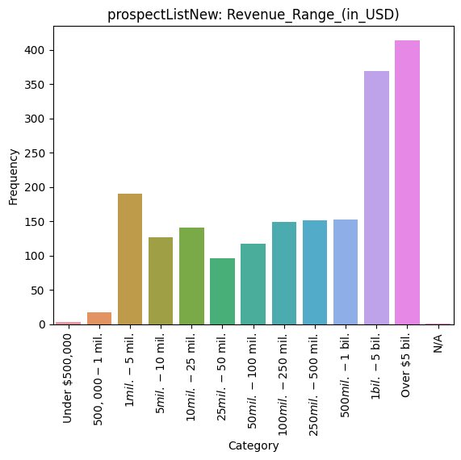
Summary of Approach - EDA
Conducted exploratory data analysis (EDA) on the three datasets
Printed the descriptive statistics for the quantitative columns, created various graphs for the categorical columns, and constructed a correlation heat map to test for multicollinearity
Key takeaway: the data was very skewed and nonlinear
Notes:
We began our project by conducting exploratory data analysis (EDA) on the three datasets provided by Netrality
We printed the descriptive statistics for the quantitative columns, created various graphs like pie charts and bar charts for the categorical columns, and even constructed a correlation heat map to test for multicollinearity throughout the data
Overall, we discovered that the data was very skewed and nonlinear, as most real-world problems are

Slide 4
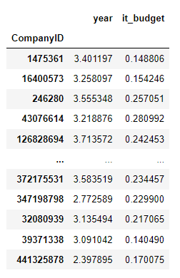
Summary of Approach - Preprocessing
Merged the billing and current customer datasets
Log transformed the data to account for skewness
Filled N/As with appropriate values and removed outliers
We altered some of the features in our dataset to enhance their influence in our machine learning models
Examples:
We changed the “founded year” column to reflect the age of the company in years by subtracting each companies' founded year from 2023
We included an IT Budget Ratio column which is a proportion of how much each company spends on its IT budget out of its entire revenue
Notes:
Our first step was to merge the billing and current customer datasets so that we could pair each company ID to its billing coefficients across each billing location
We then decided to log transform the data to account for skewness
We also altered some of the features in our dataset to enhance their influence in our machine learning models. For example, we changed the “founded year” column to reflect the age of the company in years by subtracting each companies' founded year from 2023
We included an IT Budget Ratio column which is a proportion of how much each company spends on its IT budget out of its entire revenue

Slide 5

Summary of Approach – Response Variables
We created two binary columns to act as response variables: “label” and “label2”
Summed the lifetime billing coefficients for each company and made a new column in the dataset with the totals
The “label” column which assigned a 1 to companies with above average total lifetime billing sums and a 0 to all other companies that made average or below average billing payments
The “label2” column took company size into consideration by dividing the lifetime billing coefficient sums by the number of Netrality locations each current company occupies
Companies with an average lifetime billing sum higher than the median for any given location were assigned a 1 in the “label2” column while all other companies received a 0
Notes:
We created two binary columns to act as response variables: “label” and “label2”
summed the lifetime billing coefficients for each company and made a new column in the dataset with the totals
We chose to use the lifetime billing coefficients over last month’s billing coefficients since we believed that the lifetime billing data better encompasses the billing history of each company at their billing locations and that last month’s data could simply be an outlier
The “label” column which assigned a 1 to companies with above average total lifetime billing sums and a 0 to all other companies that made average or below average billing payments
The “label2” column took company size into consideration by dividing the lifetime billing coefficient sums by the number of Netrality locations each current company occupies
Companies with an average lifetime billing sum higher than the median for any given location were assigned a 1 in the “label2” column while all other companies received a 0

Slide 6
Summary of Approach – Model Execution
Label
Logistic
kNN
XGB
LBGM
Decision trees
Random Forrest
Extra trees
GB
Recommended List
Label2
Logistic
kNN
XGB
LBGM
Decision trees
Random Forrest
Extra trees
GB
Final List
Recommended List 2
Notes:
We ran a variety of supervised and unsupervised machine learning models to construct the most accurate list of recommended companies using a 25%/75% train/test split and 1,000 iterations
Unfortunately, the accuracy scores of each individual model failed to surpass 65% and no further preprocessing measures were able to improve this
We decided to improve the accuracy score of our final recommended list by taking the set difference of all our models run twice; once using “label” as the response variable and another time using “label2” as our response variable
Then from the two recommendation lists produced using both response variables, we took the set difference one more time to create a final dataframe of 298 recommended companies which we believe to have an accuracy score of 99.93%
This accuracy and method of constructing our list was made possible through the law of independent events in statistics which proves that the false positivity rate of our final recommended list drops significantly when taking this set difference

Slide 7
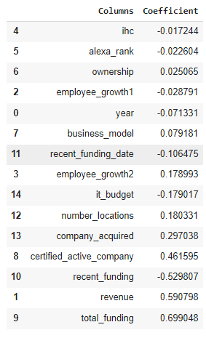
Feature Engineering
Logistic regression results
Shows most significant and influential variables
Coefficients: the expected change in log odds of having the outcome per unit change

Slide 8
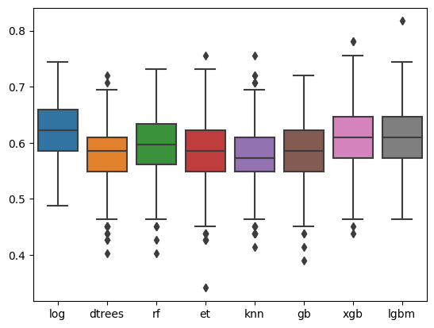
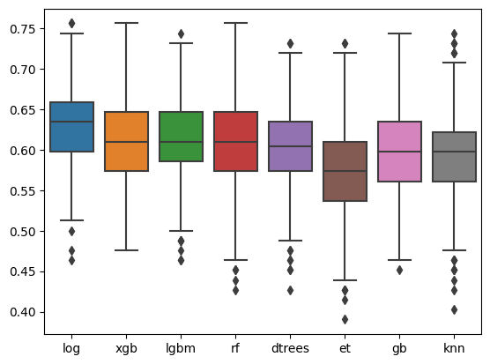
Model Accuracy Plots
“label”
“label2”

Slide 9
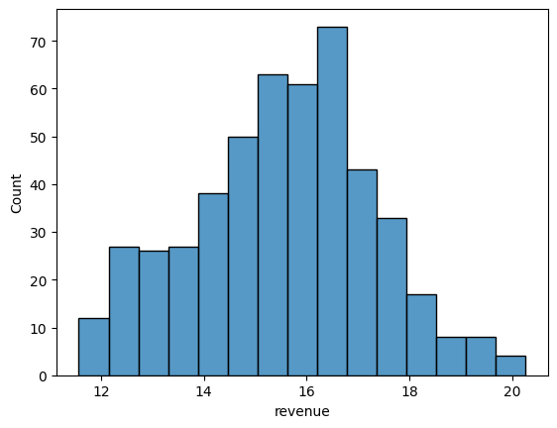
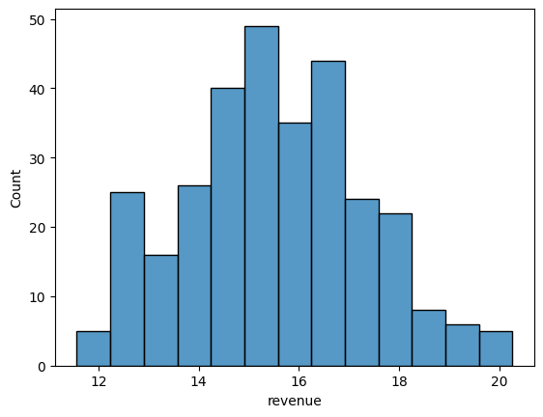
Revenue Distribution of Recommended Lists
“label”
“label2”

Slide 10
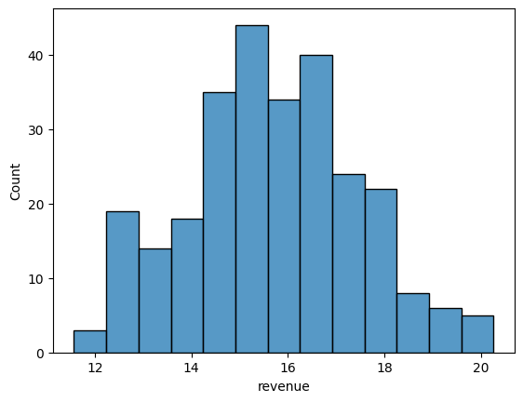
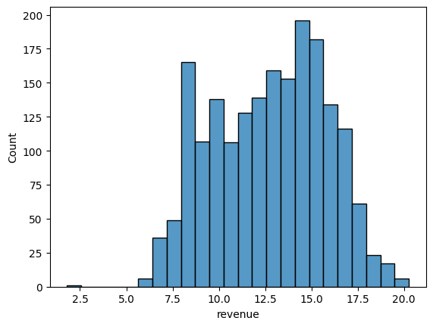
Revenue Distribution: Final List vs Actual
Final List
Actual

